Slide 1



Slide 2



01CE0701 – Mobile Computing
Unit - 7
Mobile Ad hoc Wireless Network

Slide 3


Outline
Ad –hoc Networks
Introduction of Mobile Ad-hoc Network
Classification of ad-hoc routing protocol
AODV
DSDV
AODV vs DSDV

Slide 4
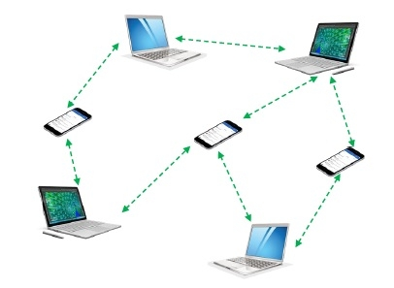
Outline
What is ad-hoc network?
An ad hoc network is one that is spontaneously formed when devices connect and communicate with each other
Ad hoc networks are mostly wireless local area networks (LANs). The devices communicate with each other directly instead of relying on a base station or access points as in wireless LANs for data transfer co-ordination. Each device participates in routing activity, by determining the route using the routing algorithm and forwarding data to other devices via this route.

Slide 5
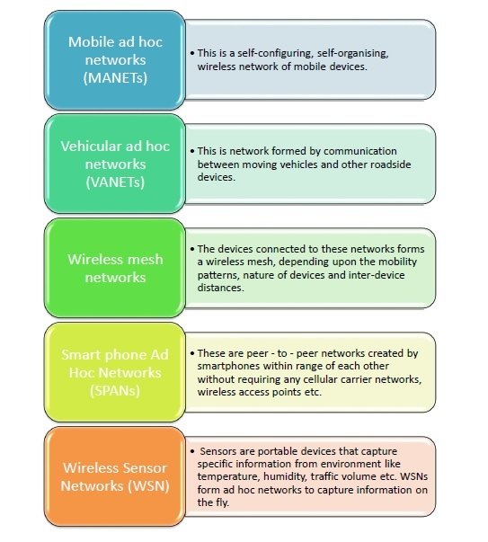
Outline
Classifications of Ad Hoc Networks
Ad hoc networks can be classified into several types depending upon the nature of their applications. The most prominent ad hoc networks that are commonly incorporated are illustrated in the diagram.

Slide 6

Introduction of MANET

Slide 7
Introduction of MANET
Now a days mobile ad-hoc network become very popular.
Mobile Network provide mobility in network.
So every node become moving free within network.
There are two different wireless network available:
Infrastructure (network with fixed and wired gateways) network
Infrastructure less network

Slide 8
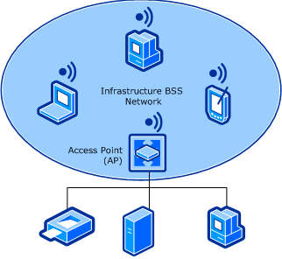
Introduction of MANET
Infrastructure Network
In infrastructure network one Access point (AP) and other Basic Service Sets (BSS) are connected through AP. Ex., Cellular Network.

Slide 9
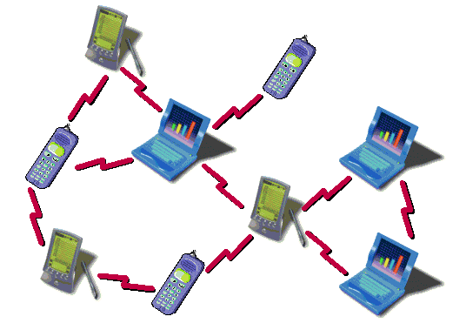
Introduction of MANET
Infrastructure less Network
Infrastructured less network also called Ad-hoc network.
Mobile ad-hoc network is collection of mobile nodes, which create temporary network without any centralized device.
In ad-hoc network all the mobile node connected with each other without AP. In ad-hoc network no fixed routers.
So all node are continously moving here and there and be connected in an arbitary manner.
These node act as a router which find and maintain route between other nodes in network.

Slide 10
Introduction of MANET
Ad-hoc vs Infrastructure Network
Ad-hoc network | Infrastructure network
Infrastructure less network | Infrastructure network
No base station, and rapid deployment | Fixed, Pre-located cell sites and base station
Highly dynamic network topologies with multi hop | Static backbone network topology
Hostile environment (noisy) and irregular connectivity | Relatively caring environment and stable connectivity
No detailed planning | Detailed planning before base station can be installed
Cost-effective | High setup costs
Less setup time | Large setup time
Ex., Bluetooth Network, Laptop to laptop wireless connection | Ex., Cellular Network

Slide 11
Application of MANET
Military: An ad hoc networking will give access to the army to maintain an network among all the soldiers, vehicles and headquarters.
Personal area network (PAN): It is a short range, local network where each nodes are usually related with a given range.
Crisis Condition: Because it is fairly easy to create it can be used in time of crisis to send emergency signals.
Medical Application: It can use to monitor patient.
Environmental Application: It can be used to check weather condition, forest fire, tsunami etc.

Slide 12
Characteristics of MANET
Dynamic Topologies: Network topology which is typically multi-hop may change randomly and rapidly with time, it can form unidirectional or bi-directional links.
Bandwidth constrained, variable capacity links: Wireless links usually have lower reliability, efficiency, stability, and capacity as compared to a wired network.
Autonomous Behavior: Each node can act as a host and router, which shows its autonomous behavior.
Energy Constrained Operation: As some or all the nodes rely on batteries. Mobile nodes are characterized by less memory, power, and lightweight features.
Limited Security: Wireless networks are more vulnerable to to security threats. A centralized firewall is absent due to the distributed nature of the operation for security, routing, and host configuration.
Less Human Intervention: They require minimum human intervention to configure the network, therefore they are dynamically autonomous in nature.

Slide 13
Benefits of MANET
Separation from central network administration.
Each node can play both the roles i.e. router and host showing autonomous nature.
Self-configuring and self-healing nodes do not require human intervention.
Highly scalable and suits the expansion of more network hub.

Slide 14
Limitations of MANET
Resources are limited due to various constraints like noise, interference conditions, etc.
Lack of authorization facilities.
More susceptible to attacks due to limited physical security.
High latency i.e. There is a huge delay in the transfer of data between two sleeping nodes.

Slide 15
Classification of Ad-hoc routing protocol

Slide 16
Classification of Ad-hoc Routing Protocol
Routing: Routing is the process of finding the best path for traffic in a network, or across multiple networks.
Routing in a mobile ad-hoc network depends on many factors such as:
Forming of the topology,
Selection of routers,
Initiation of a route request,
Finding the path effectively.
In a MANET, each node or device is expected to serve as a router. Same routing algorithm will be execute on all the routers to compute paths through the entire network.
There are two types of routing protocols:
Unicast routing protocol
The routing protocols those consider sending information to a single destination from a single source.
Multicast routing protocol
The routing protocols consider sending information to a group of destinations from a single source. Multicast routing protocols for MANET use both multicast and unicast for data transmission.

Slide 17
Classification of Ad-hoc Routing Protocol
Proactive or Table Driven
Same as link-state and distance-vector routing protocol.
Maintains route of each node in network
Periodic routing table exchange
Continuously changing routing table high control overhead.
Packet forwarding with low latency in compare to reactive approach
Longer route convergence time
Examples : WRP, OLSR, CGSR, DSDV
Reactive or On-demand
Source builds routing on demand by “flooding”
Maintain only active routes
Typically, less control overhead, better scaling properties
Drawback: long delay in finding the route
May not be suitable for real-time traffic
Example: AODV, DSR

Slide 18
Classification of Ad-hoc Routing Protocol
Unicast routing protocol
Proactive or Table Driven
Reactive or On-demand

Slide 19
AODV

Slide 20
AODV
Introduction
AODV stands for Ad-hoc On-demand Distance Vector Routing Protocol.
AODV is On-demand or Reactive routing protocol.
In AODV, overhead depends on mobility of nodes in network. Less overhead in compare to DSDV protocol.
The AODV protocol builds routes between nodes only if they are requested by source nodes.
The routes are maintained as long as they are required by the sources.
Route remain identical until a packet forwarding error occurs, i.e. a change in the network topology means that the packet is not transferable anymore.
AODV is more scalable in compare DSDV.
Notes:
Routing Table: A routing table is a set of rules, often viewed in table format, that is used to determine where data packets traveling over an Internet Protocol (IP) network will be directed. All IP-enabled devices, including routers and switches, use routing tables.

Slide 21
AODV
In AODV source node not carry the complete path.
Each Node only knows its previous and the next hop Information.
Each node maintains a route cache.
In AODV, along with routing tables of every node, two counters including Sequence Number (SEQ NO) and broadcast ID are maintained also.
The destination IP is already known to which data is to be transferred from source.
Thus, the destination Sequence Number(SEQ NO) helps to determine an updated path from source to destination.
AODV consist of 3 types of routing messages
Route Request (RREQ)
Route Reply (RREP)
Route Error (RERR)

Slide 22
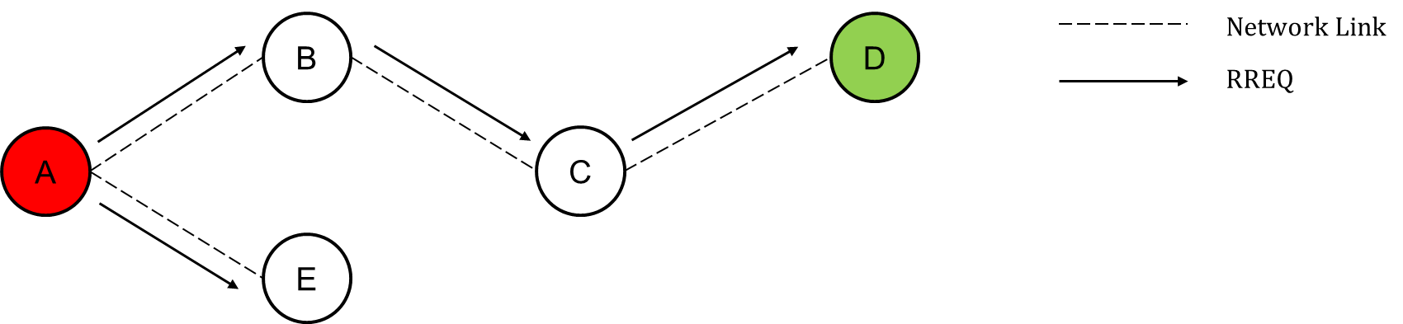
AODV
Route Request (RREQ): A node, Initiates to send/transmit a packet but doesn’t know how to get there, it sends an RREQ multicast message to start the route discovery process. Neighboring nodes keep track of where the message originated and move it on to their neighbors before it reaches the destination node.
Route request packet includes:
RREQ {Destination IP, Destination Sequence Number, Source IP, Source Sequence Number, Hop Count}

Slide 23
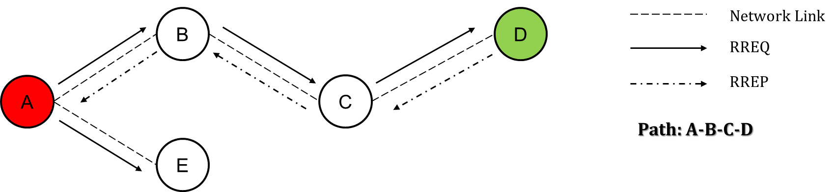
AODV
Route Reply (RREP): The destination node responds with an RREP, which returns to the source through the path taken by the RREQ. As the RREP returns to the source, forward routes are formed in the intermediate nodes. If an intermediate node knows the path to the destination, it may send an RREP in response to a received RREQ, allowing nodes to enter an established route. Communication between the source and the destination will begin once the RREP arrives at the source and the route is established.

Slide 24
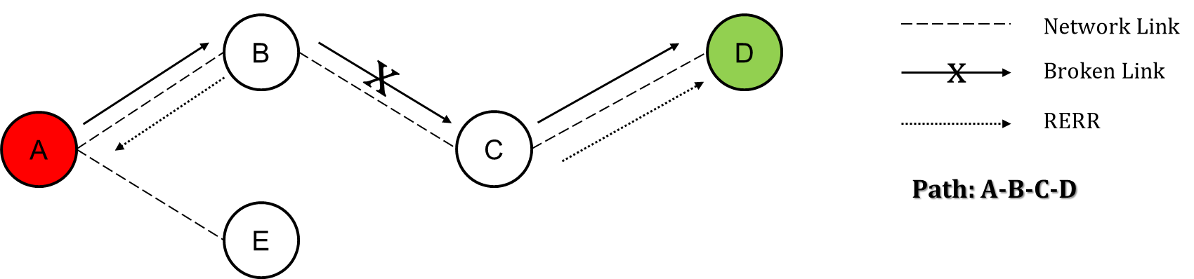
AODV
Route Error (RERR): AODV typically has less overhead as a reactive protocol (less route maintenance messages) than proactive. In the event of the connection interruption that the path no longer functions, i.e. messages cannot be sent, a RERR message is sent through a node detecting the link interruption. The message is re-cast by other nodes. The RERR message shows the unattainable destination. Message receiving nodes inactivates the route.

Slide 25
AODV
Working of AODV
Step-1: Source node “A” will send Route Request i.e. RREQ packet to its neighbours “B” and “E”.
Step 2: Node “B” & “E” will check for route and will respond using RREP packet back to source “A”. Here in this case “E” is the last node but not the destination. It will send the RREQ packet to “A” stating “Route Not Found”. But node “B” will send RREP packet stating “Route Found” and it will further broadcast the RREP to node “C”.

Slide 26
AODV
Working of AODV
Step 3: Now the field of next hop in the RREQ format will be updated, Node “C” will send back the “Route Found” message to Node “B” and will update the next hop field further.
Step 4: Then Node “C” will broadcast and RREQ packet to Node “D”, which is the destination and the next hop field is further updated. Then it will send RREP packet to “C” which will further be sent back to the source node “A” via node “B” and Node “C” resulting in generation of an optimal path.

Slide 27
AODV
Advantage
Dynamic networks can be handled easily.
No loop generation.
Less power consumption
Disadvantage
A delayed protocol because of its on-demand route discovery process.
High bandwidth requirement.

Slide 28
DSDV

Slide 29
DSDV
Introduction
DSDV stands for Destination Sequenced Distance Vector Routing Protocol.
DSDV is Table Driven or Proactive routing protocol.
DSDV Routing protocol is a modified version of Bellman Ford Algorithm and is based upon the concepts of Distance Vector Routing.
As we know, each node maintains a table that contains the shortest distance and the first node on the shortest path to every other node in the network.
Each entry in the table contains a sequence number assigned by the destination node.
It incorporates table updates with increasing sequence number tags to prevent loops, to counter the count-to-infinity problem, and for faster convergence.

Slide 30
DSDV
As it is a table-driven routing protocol, routes to all destinations are readily available at every node at all times.
The tables are exchanged between neighbors at regular intervals to keep an up-to-date view of the network topology.
The tables are also forwarded if a node observes a significant change in local topology.
The table updates are of two types: incremental updates and full dumps.
Incremental Updates: It takes a single network data packet unit (NDPU), Incremental updates are used when a node does not observe significant changes in the local topology.
Full dumps: While a full dump may take multiple NDPUs. A full dump is done either when the local topology changes significantly or when an incremental update requires more than a single NDPU.

Slide 31
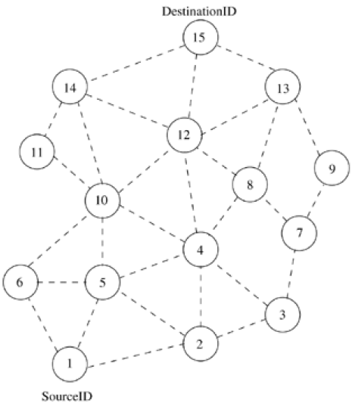
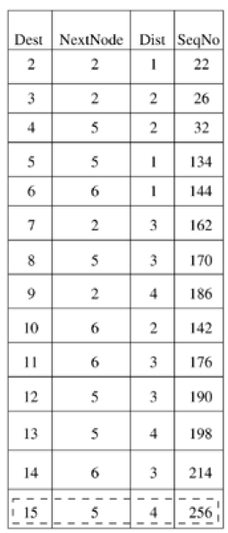
DSDV
Route Establishment
Table updates are initiated by a destination with a new sequence number which is always greater than the previous one.
Receiving an updated table, a node either updates its tables based on the received information or holds it for some time to select the best metric (which may be the lowest number of hops) received from multiple versions of the same update table from different neighboring nodes.
Based on the sequence number of the table update, it may forward or reject the table.
Network Topology
Routing table for node 1

Slide 32
DSDV
Route Establishment
Here node 1 is the source node and node 15 is the destination.
As all the nodes maintain global topology information, the route is already available as shown in table.
Here the routing table of node 1 indicates that the shortest route to the destination node (node 15) is available through node 5 and the distance to it is 4 hops.
Network Topology
Routing table for node 1

Slide 33
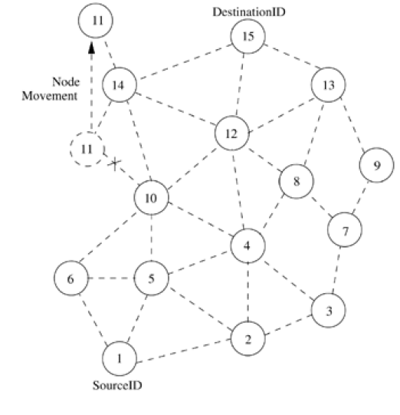
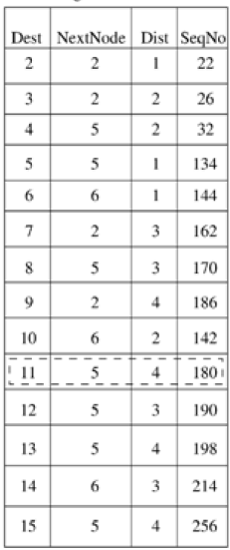
DSDV
Route maintenance
The reconfiguration of a path is handled by the protocol in the following way.
The end node of the broken link initiates a table update message with the broken link’s distance assigned to infinity (∞) and with a sequence number greater than the stored sequence number for that destination.
Each node, upon receiving an update with weight ∞, quickly broadcasts it to its neighbors in order to propagate the broken-link information to the whole network.
Thus a single link break leads to the propagation of table update information to the whole network.
Network Topology
Routing table for node 1

Slide 34
DSDV
Route maintenance
Consider the case when node 11 moves from its current position, as shown in figure.
When a neighbor node recognizes the link break, it sets all the paths passing through the broken link with distance as ∞.
For example, when node 10 knows about the link break, it sets the path to node 11 as ∞ and broadcasts its routing table to its neighbors.
Those neighbors detecting significant changes in their routing tables rebroadcast it to their neighbors.
In this way, the broken link information propagates throughout the network.
Network Topology
Routing table for node 1

Slide 35
DSDV
Route maintenance
Node 1 also sets the distance to node 11 as ∞.
When node 14 receives a table update message from node 11, it informs the neighbors about the shortest distance to node 11.
This information is also propagated throughout the network.
All nodes receiving the new update message with the higher sequence number set the new distance to node 11 in their corresponding tables.
Table shows the updated table at node 1, where the current distance from node 1 to node 11 has increased from three to four hops.
Network Topology
Routing table for node 1

Slide 36
DSDV
Advantage
Efficient results will be produced if applied on small networks.
Faster route establishment.
Disadvantage
High power consumption.
Heavy control overhead.
Not suitable for large number of networks which are dynamic in nature.

Slide 37
AODV vs DSDV

Slide 38
AODV vs DSDV
AODV | DSDV
AODV stands for Ad-hoc on Demand Distance Vector Routing Protocol. | DSDV stands for Destination Sequenced Distance Vector Routing Protocol.
AODV is reactive protocol. | DSDV is proactive protocol.
High end-to-end delay. | Less end-to-end delay.
In AODV throughput is high. | In DSDV throughput is low.
Less Power Consumption. | High Power Consumption.
Good Quality of Service (QoS) in compare to DSDV. | Poor Quality of Service (QoS) in compare to AODV.
It supports unicasting and multicasting. | It supports unicasting only.
It performs better for larger network. | It performs better for small network.

Slide 39

Thank
You

